Slide 1
Unit 3: The Skinny on Skin—Integumentary System
Review
Aim: How can we represent the structures of the integumentary system?
Objective:
I will recreate the structures of the integumentary system by creating a poster.
AGENDA
Do Now
Introduction
Mini-Lesson
Summary
Work Period
QUIZ:
(You have 10 minutes—Put everything away!)
Exit Slip

Slide 2
Unit 3: The Skinny on Skin—Integumentary System
Review
Aim: How can we represent the structures of the integumentary system?
Announcements
Due TODAY:
Thanksgiving Project: Create/Make up your own patient file based on accurate information from an abnormal/weird disease.
Unit 2 Exam Tracker
AGENDA
Do Now
Introduction
Mini-Lesson
Summary
Work Period
Exit Slip

Slide 3
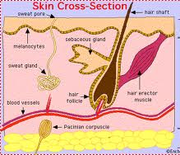
Unit 3: The Skinny on Skin—Integumentary System
Review
Aim: How can we represent the structures of the integumentary system?
Skin cross section
Do Now
Introduction
Mini-Lesson
Summary
Work Period
Exit Slip

Slide 4
Unit 3: The Skinny on Skin—Integumentary System
Review
Aim: How can we represent the structures of the integumentary system?
tasK: create a skin poster
In groups of 4:
Make a collage of parts of skin
Materials:
Poster paper
Construction paper
markers
Do Now
Introduction
Mini-Lesson
Summary
Work Period
Exit Slip

Slide 5
Unit 3: The Skinny on Skin—Integumentary System
Review
Aim: How can we represent the structures of the integumentary system?
tasK: create a skin poster
Must include
Title: “Parts of Integumentary System”
Parts of skin cut from construction paper
Labels that include name of part + function of part
Do Now
Introduction
Mini-Lesson
Summary
Work Period
Exit Slip

Slide 6
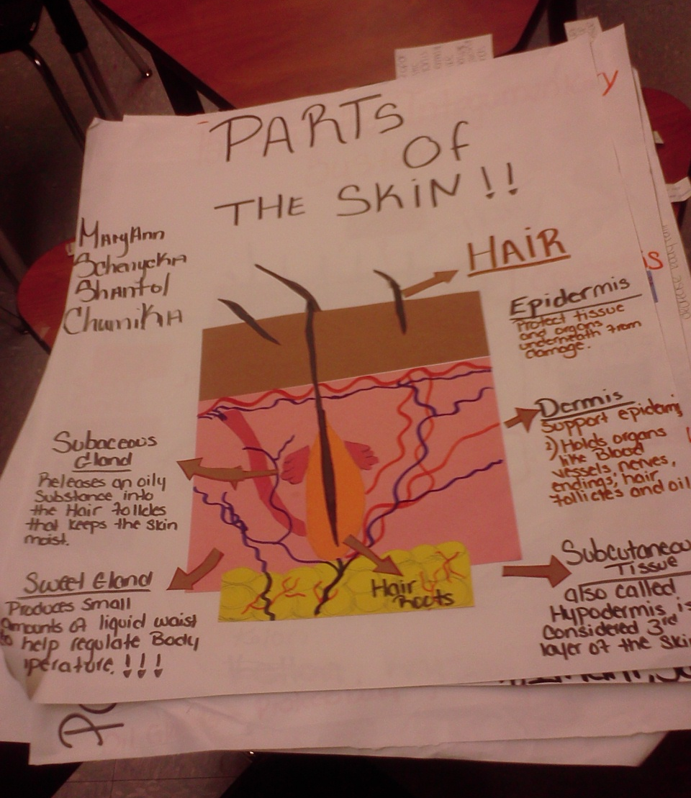
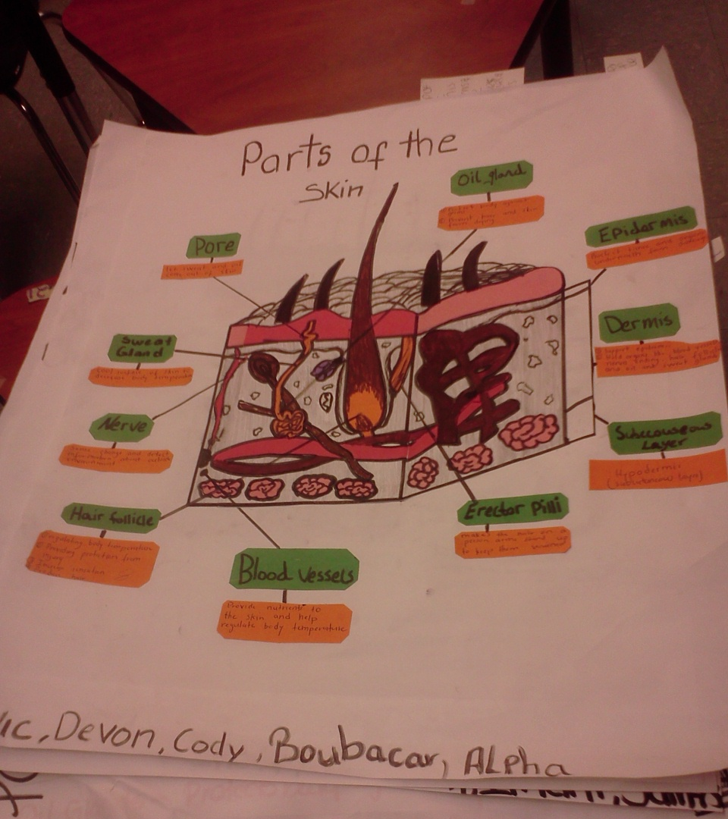
Unit 3: The Skinny on Skin—Integumentary System
Review
Aim: How can we represent the structures of the integumentary system?
tasK: create a skin poster
Do Now
Introduction
Mini-Lesson
Summary
Work Period
Exit Slip

