Slide 1
Physician assistant,nurse practitioners
Carnell kieth s.jr, Delroy Manning
03/12/2014 pr.2

Slide 2
WHAT ?
Physicaian assistant-aka pa,s ,practice medicine on a team supervised under physicians and surgeons
Nurse practitioners-aka np,s ,advanced nurses who provide care throughout the life span of a patient.

Slide 3
WHERE,APPAREL
Physician assistance-office hospitals schools.(local private government)
Blue suit,white jacket
Nurse practitioners-clinic office hospital rural areas.
Lab coats with white, and blue bottom and or top.

Slide 4
Daily routine
Physician assistant:http://www.youtube.com/watch?v=q3yFYnFakxM
Nurse practitioner:http://www.youtube.com/watch?v=q4rsx4BbDsk

Slide 5
Education license certificate
Nurse practitioner:masters,doctorate,ph.d
Physician assistant:all states require to pass the pance test including having a masters doctorate .pa programs are approximately 27 months long.

Slide 6
Qualities/qualifications
Nurse practitioner:speaking,active listening,reading comprehension,science,critical thinking.
Physician assistant:monitoring,critical thinking,reading comprehension,speaking,active listening

Slide 7
The money $$$
Physician assistant:median-92,270
Nurse paractitioner:median-91,450

Slide 8
Job outlook
The job outlook(how the people society and officials percieve it to make a living)for the both of these positions is excellent.the growth of them continue and will be needed even more in the future.

Slide 9
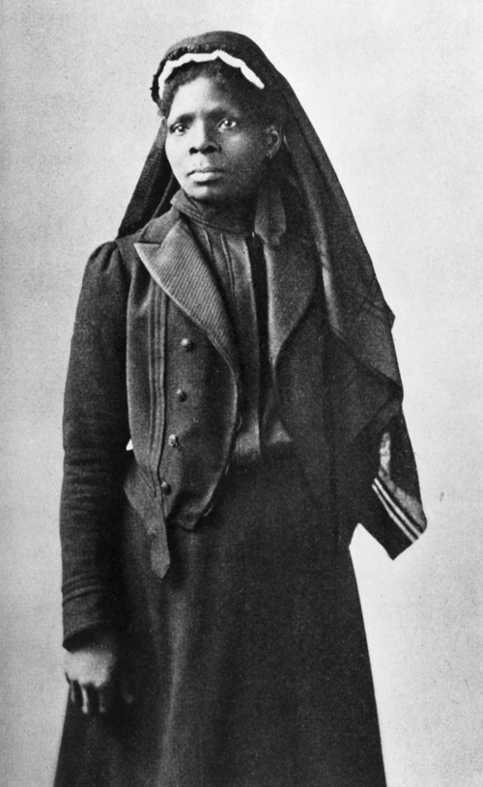
skt
Susie King Taylor was an exceptional woman with many talents. During the American Civil War, she worked as a volunteer for the Union Army, handling diverse tasks such as laundering clothes, teaching soldiers how to read and write, and making custard using turtle eggs. She also knew how to handle a musket and was a pretty good shot.
But primarily Taylor was a nurse – and a daring one at that. When some of the soldiers were quarantined after coming down with smallpox, she crept into their tents and nursed them back to health, even though this was not permitted. “I was not the least afraid of the smallpox,” she said. It was the men she cared about. As she stated years afterward, “All this time my interest in the boys in blue had not abated. I was still loyal and true, whether they were black or white.”
Later, Taylor wrote an autobiographical account of her experiences titled Reminiscences of My Life In Camp with the 33d US Colored Troops. In the book, she reflects on the bad treatment of African Americans and hopes for a time when different races might live together in harmony.

Slide 10
Why ,whats the importance?
To be a nurse practitioner and a physician assistant is vital to the human race.health is the only factor that matters at the end of the day to keep us living our lifes.with those positions and others that are similar such as a doctor peole are in a position where we have a chance to be saved from death or get checked out if our bodys have error that occurs.we need them and they need us.

Slide 11
Questions for my school mates!!!
What do you think of the presentation,are you interested
Is any one interested in persuing one of these careers
Are any of your parents in this line of work

Slide 12
conclusion
Collaborating on this whole project with delroy was a blast.it was simply education for me and hopefully for others and I had fun.there was a lot I didn’t know and that nurse practioners and physician assistants are very important in our lifes.yes they are.i didn’t know that there were different types of positions that you could work in depending on your experience.me and delroy both worked well together and are the most phenominal group to do this .getcha weight up.thank you

Slide 13
Sources to find more information
Nurse practitioners- aanp.org
Explorehealthcareers.org
Physician assistant- aapap.org
Paeaonline.org

