Slide 1
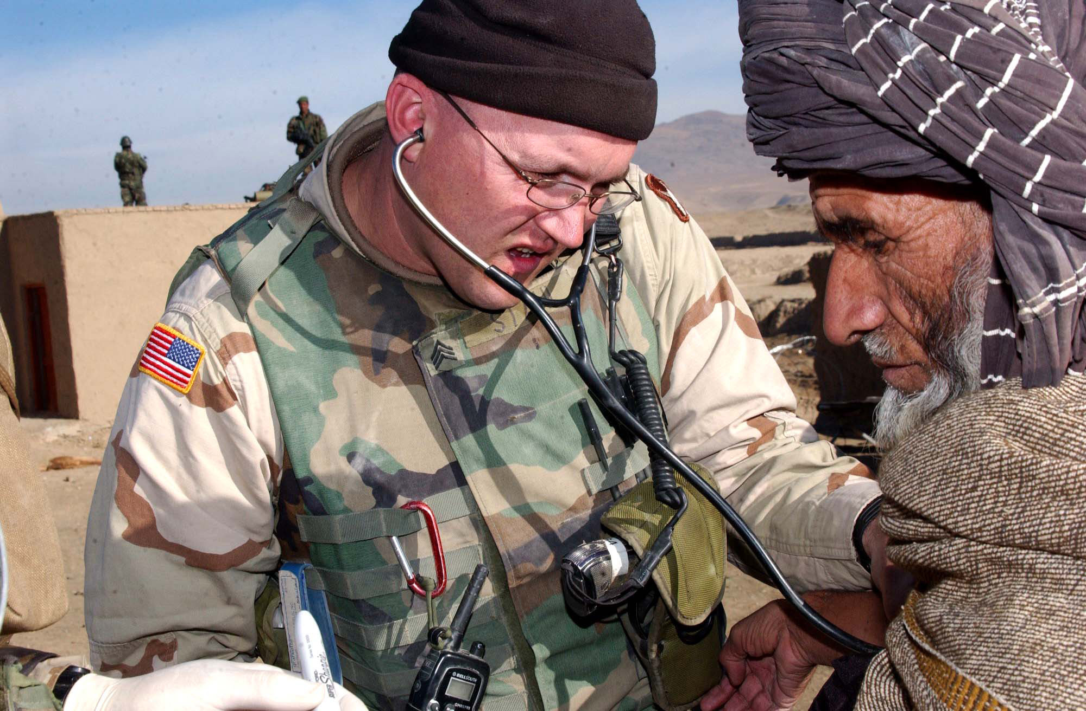
By: Dineage Joseph Naquarn Charlemgne
Medical Assistant

Slide 2
Overview
a medical assistant complete administrative and clinical task:
Patient examination
Schedule appointment
Prepare blood for laboratory tests

Slide 3
Work Environment
A medical assistant wear scrubs can work in offices of :
Physicians
Pediatrics
Chiropractors
And also other health practitioners

Slide 4
Daily routine
http://www.careerinfonet.org/occ_rep_vidpopup.asp?soccode=319092&matchVideo=31-9092.00

Slide 5
Questions on video
What was the patient diagnosed with and what was the cause of the disease?
What was the first step he took to treating the patient?
Why was those steps necessary?

Slide 6
Daily Routine
A medical assistant daily routine includes:
Filing patients records
Arranging for hospital admissions
Filing out insurance forms
Recording vital signs
Explaining treatment procedures
Preparing patients for x-rays

Slide 7
Qualifications - Education
To become a medical assistant:
Graduate from post secondary education (accredited program)
Training takes from a couple months to a year and half

Slide 8
Qualifications - Licensure
To become a medical assistant:
A certificate is not required but most employers prefer to hire certified assistant

Slide 9
Important Qualities
Skills needed to be a medical assistant:
Clinical skills
Good communication skills
Administrative skills

Slide 10
Salary
A medical assistant get paid :
$30,550
$14.69/hour

Slide 11
Job Outlook
19,236 jobs are available for this career field
the amount of jobs available will increase much faster than any other medical field
It is also the faster growing occupations

Slide 12
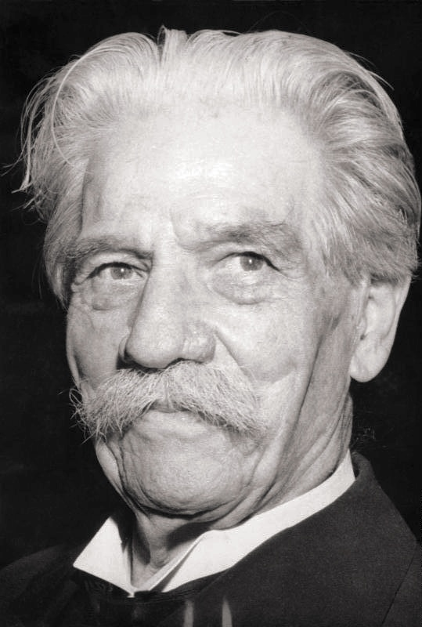
Minorities in the field
Albert Schweitzer was a famous minority

Slide 13
Significance
Being a medical assistant is important because:
It’s a career field in which people can help each other
Employment growth increase
Get trained in less than a year
It is also a career to be proud of and can benefit from it

Slide 14
Questions
What did you learn from our presentation about medical assistant?
Based on the power point what does a medical assistant daily life include?

Slide 15
Conclusion
From doing the project I learned:
Being a medical assistant requires you to be patient
Also it requires you to have great communication skill

Slide 16
Evidence
My information came from :
http://www.medical-assistant-career.com/articles/three-great-reasons-why-you-should-become-a-medical-assistant.php
http://www.bls.gov/ooh/healthcare/medical-assistants.htm

