Slide 1
Unit 4: Bones-Jointz-In-Harmony: Skeletal System
4.2
Aim: What are the structures
of the axial skeleton?
Objective:
I will identify the major bones
of the axial skeleton.
AGENDA
Do Now
Introduction
Mini-Lesson
Summary
Work Period
Do now:
You have 5 minutes
(Complete multiple choice on page 6)
Exit Slip

Slide 2
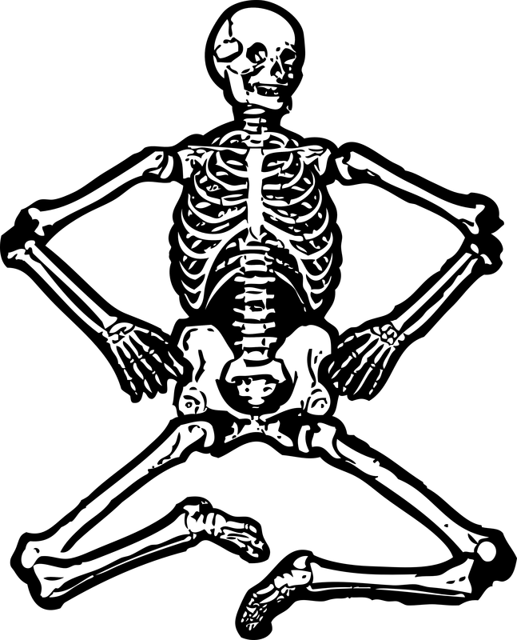
Unit 4: Bones-Jointz-In-Harmony: Skeletal System
4.2
Aim: What are the structures
of the axial skeleton?
Real-world connection
Protection of most important organs of our body (brain, heart, spine)
Vocabulary
Appendicular Skeleton, Axial Skeleton, Mandible, Maxilla, Orbit, Nasal Bone, Parietal bone, Occipital Bone, Frontal bone, Temporal bone, Zygomatic bone, Sternum, Costal Cartilage, True Ribs, False Ribs, Floating Ribs, Thoracic, Lumbar, Cervical Coccyx, Sacrum
AGENDA
Do Now
Introduction
Mini-Lesson
Summary
Work Period
Exit Slip

Slide 3
Unit 4: Bones-Jointz-In-Harmony: Skeletal System
4.2
Aim: What are the structures
of the axial skeleton?
ANNOUNCEMENTS
Project is due Tues 1/21/14
Quiz on 4.1-4.3 on Thursday!
AGENDA
Do Now
Introduction
Mini-Lesson
Summary
Work Period
Exit Slip

Slide 4
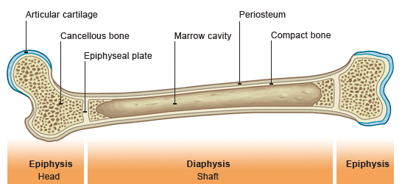
Unit 4: Bones-Jointz-In-Harmony: Skeletal System
4.2
Aim: What are the structures
of the axial skeleton?
Answer key
AGENDA
Do Now
Introduction
Mini-Lesson
Summary
Work Period
Exit Slip

Slide 5
Unit 4: Bones-Jointz-In-Harmony: Skeletal System
4.2
Aim: What are the structures
of the axial skeleton?
Class work
Let’s go over multiple choice…RAISE # of fingers to refer to answer
(you have 5 minutes)
AGENDA
Do Now
Introduction
Mini-Lesson
Summary
Work Period
Exit Slip

Slide 6
Unit 4: Bones-Jointz-In-Harmony: Skeletal System
4.2
Aim: What are the structures
of the axial skeleton?
Class work questions
1. Which of the following is NOT a function of the skeletal system?
protection
support
manufacture of red blood cells
synthesis of growth hormones
Do Now
Introduction
Mini-Lesson
Summary
Work Period
Exit Slip

Slide 7
Unit 4: Bones-Jointz-In-Harmony: Skeletal System
4.2
Aim: What are the structures
of the axial skeleton?
Class work questions
2. The bone marrow that produces blood cells is found in __________.
developing bone
spongy bone
compact bone
strong bone
Do Now
Introduction
Mini-Lesson
Summary
Work Period
Exit Slip

Slide 8
Unit 4: Bones-Jointz-In-Harmony: Skeletal System
4.2
Aim: What are the structures
of the axial skeleton?
Class work questions
3. The periosteum _________________.
is found woven within spongy bone
lines the inner cavity of the long bone and contains blood vessels
covers the ends of a long bone to cushion it
covers the outer surface of the bone and contains fibroblasts, osteoblasts, and nerve endings
Do Now
Introduction
Mini-Lesson
Summary
Work Period
Exit Slip

Slide 9
Unit 4: Bones-Jointz-In-Harmony: Skeletal System
4.2
Aim: What are the structures
of the axial skeleton?
Class work questions
4. The name spongy bone refers to the _______________.
latticework of air spaces
ability to absorb nutrients
wet outer surface of the bone
soft touch
Do Now
Introduction
Mini-Lesson
Summary
Work Period
Exit Slip

Slide 10
Unit 4: Bones-Jointz-In-Harmony: Skeletal System
4.2
Aim: What are the structures
of the axial skeleton?
Class work questions
5. Which of the following statement is INCORRECT?
Bone is where most blood cells are made.
Bone serves as a storehouse for various minerals.
Bone is a dry and non-living supporting structure.
Bone protects and supports the body and its organs.
Do Now
Introduction
Mini-Lesson
Summary
Work Period
Exit Slip

Slide 11
Unit 4: Bones-Jointz-In-Harmony: Skeletal System
4.2
Aim: What are the structures
of the axial skeleton?
Class work questions
6. The part of the bone that the articular cartilage covers
directly is the _______________.
Diaphysis
Endosteum
Epiphysis
periosteum
Do Now
Introduction
Mini-Lesson
Summary
Work Period
Exit Slip

Slide 12
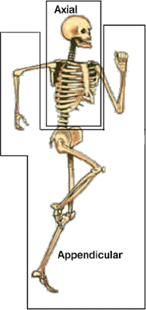
Unit 4: Bones-Jointz-In-Harmony: Skeletal System
4.2
Aim: What are the structures
of the axial skeleton?
The skeleton can be divided into
Do Now
Introduction
Mini-Lesson
Summary
Work Period
Exit Slip

Slide 13
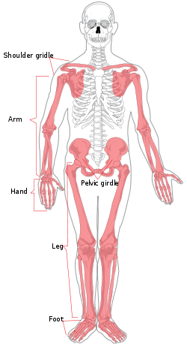
Unit 4: Bones-Jointz-In-Harmony: Skeletal System
4.2
Aim: What are the structures
of the axial skeleton?
Appendicular skeleton
Made of 126 bones.
Appendicular = adjective of the noun appendage: a part that is joined to something larger.
Involves lower limbs
Do Now
Introduction
Mini-Lesson
Summary
Work Period
Exit Slip

Slide 14
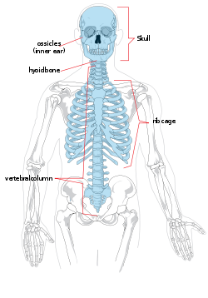
Unit 4: Bones-Jointz-In-Harmony: Skeletal System
4.2
Aim: What are the structures
of the axial skeleton?
axial skeleton
Made of 80 bones.
Made of the bones of the head and trunk of an organism.
Do Now
Introduction
Mini-Lesson
Summary
Work Period
Exit Slip

Slide 15
Unit 4: Bones-Jointz-In-Harmony: Skeletal System
4.2
Aim: What are the structures
of the axial skeleton?
Functions of axial skeleton
Supports and protects the brain, spinal cord, and organs in ventral (front) body cavities
Provides surface for muscles to attach
Do Now
Introduction
Mini-Lesson
Summary
Work Period
Exit Slip

Slide 16
Unit 4: Bones-Jointz-In-Harmony: Skeletal System
4.2
Aim: What are the structures
of the axial skeleton?
parts of axial skeleton
Skull
Rib cage
vertebrae
Do Now
Introduction
Mini-Lesson
Summary
Work Period
Exit Slip

Slide 17
Unit 4: Bones-Jointz-In-Harmony: Skeletal System
4.2
Aim: What are the structures
of the axial skeleton?
Axial Skeleton—Skull
Skull = cranium
Do Now
Introduction
Mini-Lesson
Summary
Work Period
Exit Slip

Slide 18
Unit 4: Bones-Jointz-In-Harmony: Skeletal System
4.2
Aim: What are the structures
of the axial skeleton?
Do Now
Introduction
Mini-Lesson
Summary
Work Period
Exit Slip

Slide 19
Unit 4: Bones-Jointz-In-Harmony: Skeletal System
4.2
Aim: What are the structures
of the axial skeleton?
Axial Skeleton—
Thoracic Cage = Rib Cage
Do Now
Introduction
Mini-Lesson
Summary
Work Period
Exit Slip

Slide 20
Unit 4: Bones-Jointz-In-Harmony: Skeletal System
4.2
Aim: What are the structures
of the axial skeleton?
Do Now
Introduction
Mini-Lesson
Summary
Work Period
Exit Slip

Slide 21
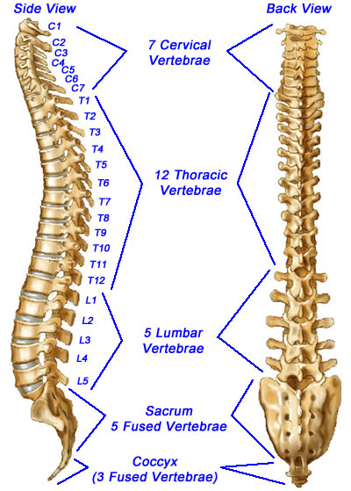
Unit 4: Bones-Jointz-In-Harmony: Skeletal System
4.2
Aim: What are the structures
of the axial skeleton?
Axial Skeleton—
Vertebral Column = Spine
Do Now
Introduction
Mini-Lesson
Summary
Work Period
Exit Slip

Slide 22
Unit 4: Bones-Jointz-In-Harmony: Skeletal System
4.2
Aim: What are the structures
of the axial skeleton?
Do Now
Introduction
Mini-Lesson
Summary
Work Period
Exit Slip

Slide 23
Unit 4: Bones-Jointz-In-Harmony: Skeletal System
4.2
Aim: What are the structures
of the axial skeleton?
Class work
Let’s go over multiple choice…RAISE # of fingers to refer to answer
(you have 5 minutes)
Do Now
Introduction
Mini-Lesson
Summary
Work Period
Exit Slip

Slide 24
Unit 4: Bones-Jointz-In-Harmony: Skeletal System
4.2
Aim: What are the structures
of the axial skeleton?
Class work questions
1. Which bone or bones does not/do not belong to the axial skeleton?
Skulls
B) Ribs
C) Hip bone
D) Spinal column
Do Now
Introduction
Mini-Lesson
Summary
Work Period
Exit Slip

Slide 25
Unit 4: Bones-Jointz-In-Harmony: Skeletal System
4.2
Aim: What are the structures
of the axial skeleton?
Class work questions
2. Which skull bone is not part of the cranium?
A) frontal
Temporal
C) Sphenoid
D) maxilla
Do Now
Introduction
Mini-Lesson
Summary
Work Period
Exit Slip

Slide 26
Unit 4: Bones-Jointz-In-Harmony: Skeletal System
4.2
Aim: What are the structures
of the axial skeleton?
Class work questions
3. Which of the following relationships is NOT correct for the regions of the vertebral column?
A) sacral—3 vertebrae fused into single bone
B) lumbar—5 vertebrae
C) cervical—7 vertebrae
D) thoracic—12 vertebrae
Do Now
Introduction
Mini-Lesson
Summary
Work Period
Exit Slip

Slide 27
Unit 4: Bones-Jointz-In-Harmony: Skeletal System
4.2
Aim: What are the structures
of the axial skeleton?
Class work questions
4. The axial skeleton consists of:
the vertebral column and skull
upper limbs, lower limbs, and pelvic girdle
the skull, vertebral column, and bony thorax (ribs and sternum)
the bony thorax, upper limbs, and pelvic girdle
Do Now
Introduction
Mini-Lesson
Summary
Work Period
Exit Slip

Slide 28
Unit 4: Bones-Jointz-In-Harmony: Skeletal System
4.2
Aim: What are the structures
of the axial skeleton?
Class work Label
Do Now
Introduction
Mini-Lesson
Summary
Work Period
Exit Slip

Slide 29
Unit 4: Bones-Jointz-In-Harmony: Skeletal System
4.2
Aim: What are the structures
of the axial skeleton?
Class work Label
Do Now
Introduction
Mini-Lesson
Summary
Work Period
Exit Slip

Slide 30
Unit 4: Bones-Jointz-In-Harmony: Skeletal System
4.2
Aim: What are the structures
of the axial skeleton?
Class work Label
Do Now
Introduction
Mini-Lesson
Summary
Work Period
Exit Slip

Slide 31
Unit 4: Bones-Jointz-In-Harmony: Skeletal System
4.2
Aim: What are the structures
of the axial skeleton?
Class work oral drill
Using skeleton in the room, I will do an oral drill.
Name the bone that I point to
Do Now
Introduction
Mini-Lesson
Summary
Work Period
Exit Slip

Slide 32
Unit 4: Bones-Jointz-In-Harmony: Skeletal System
4.2
Aim: What are the structures
of the axial skeleton?
HOMEWORK:
Finish pages for 4.2 for homework
Do Now
Introduction
Mini-Lesson
Summary
Work Period
Exit Slip

Slide 33
Unit 4: Bones-Jointz-In-Harmony: Skeletal System
4.2
Aim: What are the structures
of the axial skeleton?
Exit Slip
Make sure you get your trackers checked!
Do Now
Introduction
Mini-Lesson
Summary
Work Period
Exit Slip

