Slide 1
Unit 3: The Skinny on Skin—Integumentary System
3.7
Aim: How can we diagnose common skin diseases based on the symptoms, causes, and treatment?
Objective:
I will diagnose common skin diseases based on the symptoms, causes, and treatment.
AGENDA
Do Now
Introduction
Mini-Lesson
Summary
Work Period
Do now:
(You have 5 minutes)
PLEASE GET BINDERS!
Exit Slip

Slide 2
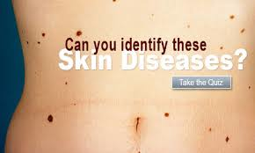
Unit 3: The Skinny on Skin—Integumentary System
3.7
Aim: How can we diagnose common skin diseases based on the symptoms, causes, and treatment?
Real-world connection
Acne, burns, other skin diseases
Vocabulary
Acne, baldness, vtiligo, psoriasis, eczema, athlete’s foot, albinism, basal cell carcinoma, squamous cell carcinoma, melanoma
AGENDA
Do Now
Introduction
Mini-Lesson
Summary
Work Period
Exit Slip

Slide 3
Unit 3: The Skinny on Skin—Integumentary System
3.7
Aim: How can we diagnose common skin diseases based on the symptoms, causes, and treatment?
Announcements
Assignment over break: Lab Report + Lab Notebook writeup for Skin Receptors Lab: Due Mon 1/6/14
Quiz on Thursday on 3.4-3.6 lessons (skin color, skin burns, hair)
Exam #3 on Friday (3.1-3.8)
AGENDA
Do Now
Introduction
Mini-Lesson
Summary
Work Period
Exit Slip

