Slide 1
Unit 3: The Skinny on Skin—Integumentary System
3.6
Aim: How does the structure & function of hair affect its aesthetic qualities?
Objective:
I will identify the structure and function of hair and analyze how they affect the aesthetic qualities of hair.
AGENDA
Do Now
Introduction
Mini-Lesson
Summary
Work Period
Do now:
(You have 5 minutes)
PLEASE GET BINDERS!
Exit Slip

Slide 2
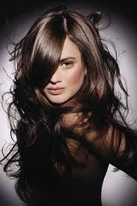
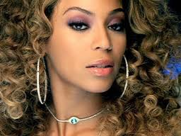
Unit 3: The Skinny on Skin—Integumentary System
3.6
Aim: How does the structure & function of hair affect its aesthetic qualities?
Real-world connection
Hair beauty (length, color, texture), hair straightening
Vocabulary
Vellus hair, terminal hair, cuticle, cortex, medulla, hair shaft, anagen, catagen, telogen
AGENDA
Do Now
Introduction
Mini-Lesson
Summary
Work Period
Exit Slip

Slide 3
Unit 3: The Skinny on Skin—Integumentary System
3.6
Aim: How does the structure & function of hair affect its aesthetic qualities?
Announcements
Not taking any more projects
Assignment over break: Lab Report + Lab Notebook writeup for Skin Receptors Lab: Due Mon 1/6/14
NOTE: Procedure in notebook is in command & listed/procedure in lab report is in past tense in a paragraph w/ transition words (first, then, finally)
AGENDA
Do Now
Introduction
Mini-Lesson
Summary
Work Period
Exit Slip

Slide 4
Unit 3: The Skinny on Skin—Integumentary System
3.6
Aim: How does the structure & function of hair affect its aesthetic qualities?
Announcements
Quiz on Thursday on 3.4-3.6 lessons (skin color, skin burns, hair)
Exam #3 on Friday (3.1-3.8)
AGENDA
Do Now
Introduction
Mini-Lesson
Summary
Work Period
Exit Slip

Slide 5
Unit 3: The Skinny on Skin—Integumentary System
3.6
Aim: How does the structure & function of hair affect its aesthetic qualities?
Hair facts
Another name for hair is pillus
Made of fused (attached together), dead, keratin cells
Human body has 2.5 million hairs
75% of hair is all over the body, NOT on the head
Humans are born with the amount of hair follicles as they will have
Do Now
Introduction
Mini-Lesson
Summary
Work Period
Exit Slip

Slide 6
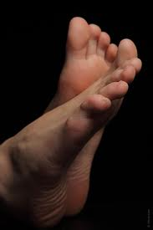
Unit 3: The Skinny on Skin—Integumentary System
3.6
Aim: How does the structure & function of hair affect its aesthetic qualities?
Where hair grows
Hair grows everywhere EXCEPT:
Sides and soles of feet
Palms of the hands
Sides of the fingers and toes
lips
Parts of external genitalia
Why do you think that is the case?
Do Now
Introduction
Mini-Lesson
Summary
Work Period
Exit Slip

Slide 7
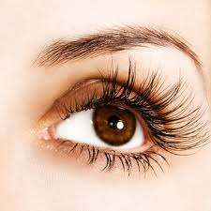
Unit 3: The Skinny on Skin—Integumentary System
3.6
Aim: How does the structure & function of hair affect its aesthetic qualities?
Functions of hair
Protect scalp from sunburn and injury
Prevent foreign particles from entering into eyes, ears, and nose
Assist in spread of body scent
Shield eyes from water, sweat, and light (i.e. eyelashes and eyebrows)
Sensory function
Do Now
Introduction
Mini-Lesson
Summary
Work Period
Exit Slip

Slide 8
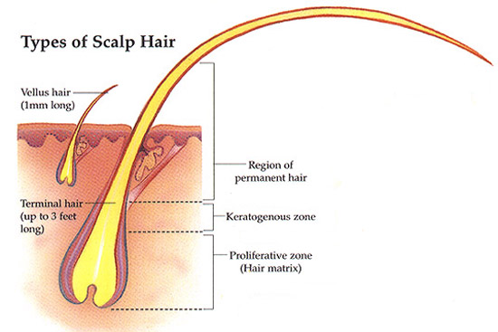
Unit 3: The Skinny on Skin—Integumentary System
3.6
Aim: How does the structure & function of hair affect its aesthetic qualities?
Types of hair
1. ______________________________
large, coarse, colored hair
found in scalp, eyebrows, eyelashes, and armpits
2. _______________________________
smaller, shorter, more delicate hair
found throughout most of body
Do Now
Introduction
Mini-Lesson
Summary
Work Period
Exit Slip

Slide 9
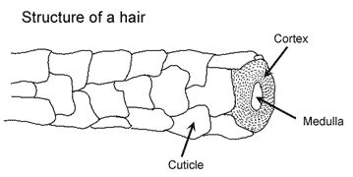
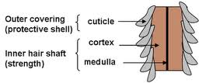
Unit 3: The Skinny on Skin—Integumentary System
3.6
Aim: How does the structure & function of hair affect its aesthetic qualities?
Structure of hair
Do Now
Introduction
Mini-Lesson
Summary
Work Period
Exit Slip

Slide 10
Unit 3: The Skinny on Skin—Integumentary System
3.6
Aim: How does the structure & function of hair affect its aesthetic qualities?
Structure of hair
Do Now
Introduction
Mini-Lesson
Summary
Work Period
Exit Slip

Slide 11
Unit 3: The Skinny on Skin—Integumentary System
3.6
Aim: How does the structure & function of hair affect its aesthetic qualities?
Hair growth cycle
anagen (ana = upward)
also called the active phase or stage of growth
What occurs: Hair grows at the rate of 0.33mm/day (6 inches a year)
Do Now
Introduction
Mini-Lesson
Summary
Work Period
Exit Slip

Slide 12
Unit 3: The Skinny on Skin—Integumentary System
3.6
Aim: How does the structure & function of hair affect its aesthetic qualities?
Hair growth cycle
Catagen (cata = downward)
also called the transitional phase
What occurs: Hair follicle gets smaller because it falls apart & detaches from blood supply
Do Now
Introduction
Mini-Lesson
Summary
Work Period
Exit Slip

Slide 13
Unit 3: The Skinny on Skin—Integumentary System
3.6
Aim: How does the structure & function of hair affect its aesthetic qualities?
Hair growth cycle
Telogen (telo = end)
also called the resting phase.
What occurs: Hair detaches from the follicle and is pushed out by new hair, becomes club hair (process called shedding)
Pulling out hair in this phase will show a solid, white material at root
Do Now
Introduction
Mini-Lesson
Summary
Work Period
Exit Slip

Slide 14
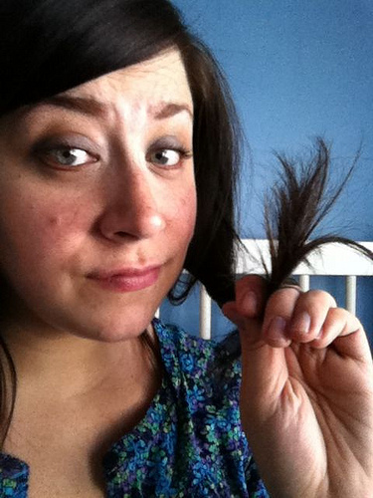
Unit 3: The Skinny on Skin—Integumentary System
3.6
Aim: How does the structure & function of hair affect its aesthetic qualities?
Why do people get split ends?
Cuticle tends to wear away at tip of hair shaft →
Keratin fibers in the hair regions frizz out
Do Now
Introduction
Mini-Lesson
Summary
Work Period
Exit Slip

Slide 15
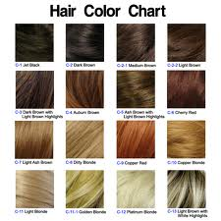
Unit 3: The Skinny on Skin—Integumentary System
3.6
Aim: How does the structure & function of hair affect its aesthetic qualities?
Why do people have different hair colors?
Hair pigment is made by melanocytes (cells that produce melanin) in hair bulb
Varying amounts of different types of melanin combines to produce different hair colors
Do Now
Introduction
Mini-Lesson
Summary
Work Period
Exit Slip

Slide 16
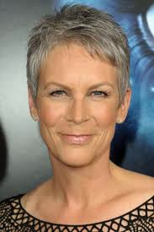
Unit 3: The Skinny on Skin—Integumentary System
3.6
Aim: How does the structure & function of hair affect its aesthetic qualities?
Why do we get
gray hair?
As you get older, the amount of melanin produced decreases → causing hair to get lighter
White hair results from:
Lack of melanin
Air bubbles in the medulla of the hair shaft
Do Now
Introduction
Mini-Lesson
Summary
Work Period
Exit Slip

Slide 17
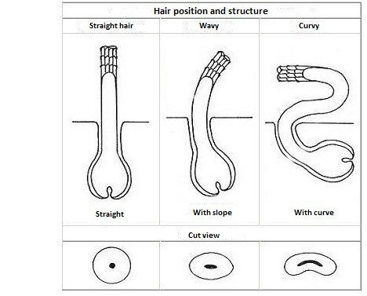
Unit 3: The Skinny on Skin—Integumentary System
3.6
Aim: How does the structure & function of hair affect its aesthetic qualities?
Different hair textures
Texture of hair depends on the shape of the hair shaft which depends on hair follicle shape
Do Now
Introduction
Mini-Lesson
Summary
Work Period
Exit Slip

Slide 18
Unit 3: The Skinny on Skin—Integumentary System
3.6
Aim: How does the structure & function of hair affect its aesthetic qualities?
Class work questions
All of the following are important functions of human hair except:
A) protecting the scalp from sunburn and injury
B) preventing entry of foreign particles into the eyes, ears, and nose
C) To make a person look beautiful
D) assisting in the dispersal of pheromones (scent)
Do Now
Introduction
Mini-Lesson
Summary
Work Period
Exit Slip

Slide 19
Unit 3: The Skinny on Skin—Integumentary System
3.6
Aim: How does the structure & function of hair affect its aesthetic qualities?
Class work questions
The relatively coarse, pigmented hair of the scalp, eyebrows, and eyelashes is
A) terminal hair
B) vellus hair
C) Club hair
D) none of the above
Do Now
Introduction
Mini-Lesson
Summary
Work Period
Exit Slip

Slide 20
Unit 3: The Skinny on Skin—Integumentary System
3.6
Aim: How does the structure & function of hair affect its aesthetic qualities?
Class work questions
The hair strand contains all of the following except
A) cuticle
B) medula
C) cortex
D) matrix
Do Now
Introduction
Mini-Lesson
Summary
Work Period
Exit Slip

Slide 21
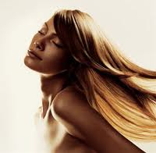
Unit 3: The Skinny on Skin—Integumentary System
3.6
Aim: How does the structure & function of hair affect its aesthetic qualities?
work period
Read Hair Straightening Article &
Answer the Questions the Follow
When it says cite evidence, make sure to quote!
Make sure to use text annotation symbols!
You lose many points for not doing both ;-)
Do Now
Introduction
Mini-Lesson
Summary
Work Period
Exit Slip

Slide 22
Unit 3: The Skinny on Skin—Integumentary System
3.6
Aim: How does the structure & function of hair affect its aesthetic qualities?
HOMEWORK:
Finish pages for 3.6 for homework
Do Now
Introduction
Mini-Lesson
Summary
Work Period
Exit Slip

Slide 23
Unit 3: The Skinny on Skin—Integumentary System
3.6
Aim: How does the structure & function of hair affect its aesthetic qualities?
Exit Slip
Make sure you get your trackers checked!
Do Now
Introduction
Mini-Lesson
Summary
Work Period
Exit Slip

