Slide 1
Unit 3: The Skinny on Skin—Integumentary System
3.4
Aim: How do we analyze what accounts for differences in skin color?
Objective:
I will analyze what
accounts for differences in skin color.
AGENDA
Do Now
Introduction
Mini-Lesson
Summary
Work Period
Do now:
(You have 5 minutes)
PLEASE GET BINDERS!
Exit Slip

Slide 2
Unit 3: The Skinny on Skin—Integumentary System
3.4
Aim: How do we analyze what accounts for differences in skin color?
Real-world connection
Different races
Vocabulary
carotene, melanin, hemoglobin, Fitzpatrick scale
AGENDA
Do Now
Introduction
Mini-Lesson
Summary
Work Period
Exit Slip

Slide 3
Unit 3: The Skinny on Skin—Integumentary System
3.4
Aim: How do we analyze what accounts for differences in skin color?
Announcements
Papers to give back
PAST DUE:
Thanksgiving Project: Create/Make up your own patient file based on accurate information from an abnormal/weird disease.
Unit 2 Exam Tracker
AGENDA
Do Now
Introduction
Mini-Lesson
Summary
Work Period
Exit Slip

Slide 4
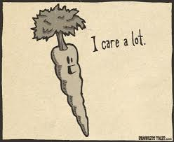
Unit 3: The Skinny on Skin—Integumentary System
3.4
Aim: How do we analyze what accounts for differences in skin color?
Bottom line
“Mental growth, like physical growth, comes with growing pains. It's not always easy. It's not always fun. It's going to hurt and you're going to come out the other side bumped and bruised... but better.”
AGENDA
Do Now
Introduction
Mini-Lesson
Summary
Work Period
Exit Slip

Slide 5
Unit 3: The Skinny on Skin—Integumentary System
3.4
Aim: How do we analyze what accounts for differences in skin color?
Factor #1: melanin
Do Now
Introduction
Mini-Lesson
Summary
Work Period
Exit Slip

Slide 6
Unit 3: The Skinny on Skin—Integumentary System
3.4
Aim: How do we analyze what accounts for differences in skin color?
Factor #2: carotene
Do Now
Introduction
Mini-Lesson
Summary
Work Period
Exit Slip

Slide 7
Unit 3: The Skinny on Skin—Integumentary System
3.4
Aim: How do we analyze what accounts for differences in skin color?
Factor #3: hemoglobin
Do Now
Introduction
Mini-Lesson
Summary
Work Period
Exit Slip

Slide 8
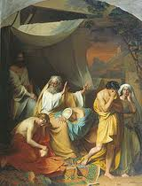
Unit 3: The Skinny on Skin—Integumentary System
3.4
Aim: How do we analyze what accounts for differences in skin color?
Theories about skin color
Theory #1: Bibical Curse
Noah’s curse on Canaan
(Genesis Chapter 9, King James Version):
24. And Noah awoke from his wine, and knew what his younger
son had done unto him.
25. And he said, Cursed be Canaan; a servant of servants shall he be unto his brethren.
26. And he said, Blessed be the LORD God of Shem; and Canaan shall be his servant.
27. God shall enlarge Japheth, and he shall dwell in the tents of Shem; and Canaan shall be his servant.
Do Now
Introduction
Mini-Lesson
Summary
Work Period
Exit Slip

Slide 9
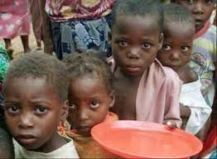
Unit 3: The Skinny on Skin—Integumentary System
3.4
Aim: How do we analyze what accounts for differences in skin color?
Theories about skin color
Theory #1: Bibical Curse
Becoming dark because of a famine
– Ch 4, v 8: Their visage is blacker than a coal (alternate translation: darker than blackness); they are not known in the streets: their skin cleaveth to their bones; it is withered, it is become like a stick.
– Ch 5, v 10: Our skin was black like an oven because of the terrible famine (alternate translations: terrors or storms)
Do Now
Introduction
Mini-Lesson
Summary
Work Period
Exit Slip

Slide 10
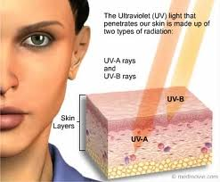
Unit 3: The Skinny on Skin—Integumentary System
3.4
Aim: How do we analyze what accounts for differences in skin color?
Theories about skin color
Theory #2: Heat of Sun/UV Radiation
slave trade at the West African coast in the mid to late 16th century
People thought sun’s heat was the cause of the differences in the complexion of Europeans and Africans
What’s wrong with that theory?
Do Now
Introduction
Mini-Lesson
Summary
Work Period
Exit Slip

Slide 11
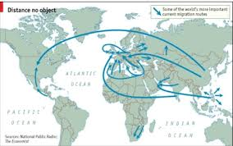
Unit 3: The Skinny on Skin—Integumentary System
3.4
Aim: How do we analyze what accounts for differences in skin color?
Theories about skin color
Theory #3: Migration
““If the fervour of the Sun, or intemperate heat of clime did solely occasion this complexion, surely a migration or change thereof might cause a sensible, if not a total mutation; which notwithstanding experience will not admit. {Despite their transplantation, there remains among their descendants} a strong shadow of their Originals: and if they preserve their copulations entire, they still maintain their complexion. . . .{L}ikewise, fair or white people translated in hotter Countries receive not impressions amounting to this complexion”
Do Now
Introduction
Mini-Lesson
Summary
Work Period
Exit Slip

Slide 12
Unit 3: The Skinny on Skin—Integumentary System
3.4
Aim: How do we analyze what accounts for differences in skin color?
Theories about skin color
Theory #3: Migration
Connected to theory about the sun
If people migrated to areas with a lot of sun, skin color will get darker
Do Now
Introduction
Mini-Lesson
Summary
Work Period
Exit Slip

Slide 13
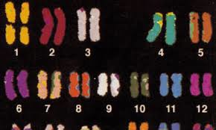
Unit 3: The Skinny on Skin—Integumentary System
3.4
Aim: How do we analyze what accounts for differences in skin color?
Theories about skin color
Theory #4: Biological Differences
Thought that skin color was innate—reasons:
Africans were found to vary in color from “black to yellow
Africans in Europe were not getting lighter and vice versa
Do Now
Introduction
Mini-Lesson
Summary
Work Period
Exit Slip

Slide 14
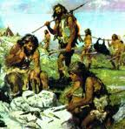
Unit 3: The Skinny on Skin—Integumentary System
3.4
Aim: How do we analyze what accounts for differences in skin color?
Theories about skin color
Theory #5: Evolution
Skin differences result of adaptation to geographical environment that passed down generations
Do Now
Introduction
Mini-Lesson
Summary
Work Period
Exit Slip

Slide 15
Unit 3: The Skinny on Skin—Integumentary System
3.4
Aim: How do we analyze what accounts for differences in skin color?
Skin color scale
Skin Color Scale: Fitzpatrick Scale
Developed in 1917 by Harvard Medical School dermatologist, Thomas Fitzpatrick
Purpose: classifies a person's complexion and their tolerance to sunlight and UV radiation
Skin type does not change, only how tan you can get
Current use: research into the color of skin and is also used to aid practitioners in the care of their patients
Do Now
Introduction
Mini-Lesson
Summary
Work Period
Exit Slip

Slide 16
Unit 3: The Skinny on Skin—Integumentary System
Aim: How do the
Do Now
Introduction
Mini-Lesson
Summary
Work Period
Exit Slip

Slide 17
Unit 3: The Skinny on Skin—Integumentary System
3.4
Aim: How do we analyze what accounts for differences in skin color?
Skin color scale
If you have Type I skin (very white), your levels of:
Melanin?:
Carotene?:
Hemoglobin?:
Is this skin type to your advantage or disadvantage? Why?
Do Now
Introduction
Mini-Lesson
Summary
Work Period
Exit Slip

Slide 18
Unit 3: The Skinny on Skin—Integumentary System
3.4
Aim: How do we analyze what accounts for differences in skin color?
Skin color scale
If you have Type VI skin (very dark), your levels of:
Melanin?:
Carotene?:
Hemoglobin?:
Is this skin type to your advantage or disadvantage? Why?
Do Now
Introduction
Mini-Lesson
Summary
Work Period
Exit Slip

Slide 19
Unit 3: The Skinny on Skin—Integumentary System
3.4
Aim: How do we analyze what accounts for differences in skin color?
work period
Pages 21-22
Do Now
Introduction
Mini-Lesson
Summary
Work Period
Exit Slip

Slide 20
Unit 3: The Skinny on Skin—Integumentary System
3.4
Aim: How do we analyze what accounts for differences in skin color?
HOMEWORK:
Finish pages for 3.4 for homework
Do Now
Introduction
Mini-Lesson
Summary
Work Period
Exit Slip

Slide 21
Unit 3: The Skinny on Skin—Integumentary System
3.4
Aim: How do we analyze what accounts for differences in skin color?
Exit Slip
Make sure you get your trackers checked!
Do Now
Introduction
Mini-Lesson
Summary
Work Period
Exit Slip

