Slide 1
Unit 3: The Skinny on Skin—Integumentary System
3.3
Aim: How do the skin’s accessory organs aid in the function of the integumentary system?
Objective:
I will identify the structure and function of the accessory organs of the integumentary system.
AGENDA
Do Now
Introduction
Mini-Lesson
Summary
Work Period
Do now:
(You have 5 minutes)
PLEASE GET BINDERS!
Exit Slip

Slide 2
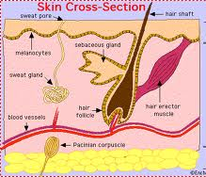
Unit 3: The Skinny on Skin—Integumentary System
3.3
Aim: How do the skin’s accessory organs aid in the function of the integumentary system?
Real-world connection
Bleeding, feeling pain, sweating
Vocabulary
Pore, Sweat Gland, Sebaceous (oil) gland, Erector Pilli, Blood vessel, Nerve, Adipose tissue (fat molecule), Hair follicle
AGENDA
Do Now
Introduction
Mini-Lesson
Summary
Work Period
Exit Slip

Slide 3
Unit 3: The Skinny on Skin—Integumentary System
3.3
Aim: How do the skin’s accessory organs aid in the function of the integumentary system?
Announcements
Papers to give back
Due Friday 12/6/13:
Thanksgiving Project: Create/Make up your own patient file based on accurate information from an abnormal/weird disease.
Unit 2 Exam Tracker
AGENDA
Do Now
Introduction
Mini-Lesson
Summary
Work Period
Exit Slip

Slide 4
Unit 3: The Skinny on Skin—Integumentary System
3.3
Aim: How do the skin’s accessory organs aid in the function of the integumentary system?
Let’s go over…tatoo reading
What makes the tattoo permanent? Which skin layer does the tattoo affect? Cite evidence.
Which skin layers are damaged during the tattoo ink placement? Cite evidence.
Which cells initially take up the ink?
Why do tattoos fade over time? Cite evidence.
What are Langerhans cells?
What effect does the sun have on tattoos? Cite evidence.
Do Now
Introduction
Mini-Lesson
Summary
Work Period
Exit Slip

Slide 5
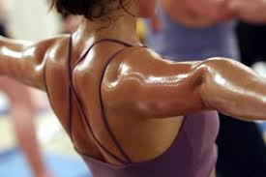
Unit 3: The Skinny on Skin—Integumentary System
3.3
Aim: How do the skin’s accessory organs aid in the function of the integumentary system?
Think ink…pair share
What about our skin helps be able to bleed, feel, and sweat? Think how that is connected to structure and function.
Do Now
Introduction
Mini-Lesson
Summary
Work Period
Exit Slip

Slide 6
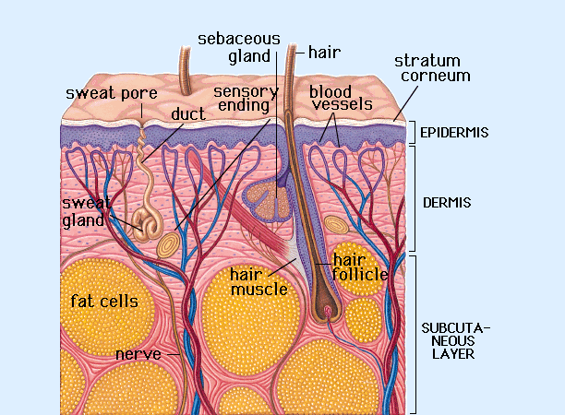
Unit 3: The Skinny on Skin—Integumentary System
3.3
Aim: How do the skin’s accessory organs aid in the function of the integumentary system?
Structure: pores
Made up Of Tiny openings on top of skin with sweat & oil glands
Function Let sweat and oil come out of skin
Do Now
Introduction
Mini-Lesson
Summary
Work Period
Exit Slip

Slide 7
Unit 3: The Skinny on Skin—Integumentary System
3.3
Aim: How do the skin’s accessory organs aid in the function of the integumentary system?
Structure: Sweat gland
Made up Of tubules
Function Cool surface of skin to decrease body temperature
Do Now
Introduction
Mini-Lesson
Summary
Work Period
Exit Slip

Slide 8
Unit 3: The Skinny on Skin—Integumentary System
3.3
Aim: How do the skin’s accessory organs aid in the function of the integumentary system?
Structure: Oil gland
Made up Of Fats & proteins
Function Protect body against germs Prevent hair and skin from drying
Do Now
Introduction
Mini-Lesson
Summary
Work Period
Exit Slip

Slide 9
Unit 3: The Skinny on Skin—Integumentary System
3.3
Aim: How do the skin’s accessory organs aid in the function of the integumentary system?
Structure: Erector pilli
Made up Of Muscles attached to hair
Function makes the hair on a person’s arm stand up to keep them warmer
Do Now
Introduction
Mini-Lesson
Summary
Work Period
Exit Slip

Slide 10
Unit 3: The Skinny on Skin—Integumentary System
3.3
Aim: How do the skin’s accessory organs aid in the function of the integumentary system?
Structure: Blood vessels
Made up Of Arteries and veins
Function provide nutrients to the skin and help regulate body temperature
Do Now
Introduction
Mini-Lesson
Summary
Work Period
Exit Slip

Slide 11
Unit 3: The Skinny on Skin—Integumentary System
3.3
Aim: How do the skin’s accessory organs aid in the function of the integumentary system?
Structure: nerve
Made up Of Sensory receptors
Function Sense change and detect information about outside environment
Do Now
Introduction
Mini-Lesson
Summary
Work Period
Exit Slip

Slide 12
Unit 3: The Skinny on Skin—Integumentary System
3.3
Aim: How do the skin’s accessory organs aid in the function of the integumentary system?
Structure: Adipose tissue
Made up Of fat
Function (1) insulate the body from heat and cold (2) provides protective padding (3) an energy storage area
Do Now
Introduction
Mini-Lesson
Summary
Work Period
Exit Slip

Slide 13
Unit 3: The Skinny on Skin—Integumentary System
3.3
Aim: How do the skin’s accessory organs aid in the function of the integumentary system?
Structure: Hair follicle
Made up Of hair
Function (1) regulating body temperature (2) providing protection from injury (3) increase sensation (4) produce hair
Do Now
Introduction
Mini-Lesson
Summary
Work Period
Exit Slip

Slide 14
Unit 3: The Skinny on Skin—Integumentary System
3.3
Aim: How do the skin’s accessory organs aid in the function of the integumentary system?
sample question
Raise # of fingers to correspond to answer
Which of the following structures is NOT housed in the dermis? a. nails b. hair follicles c. sebaceous glands d. nerve fibers
Do Now
Introduction
Mini-Lesson
Summary
Work Period
Exit Slip

Slide 15
Unit 3: The Skinny on Skin—Integumentary System
3.3
Aim: How do the skin’s accessory organs aid in the function of the integumentary system?
sample question
Raise # of fingers to correspond to answer
Which is NOT an accessory organ to the skin? a. blood vessel
b. hair c. pimples
d. Sweat gland
Do Now
Introduction
Mini-Lesson
Summary
Work Period
Exit Slip

Slide 16
Unit 3: The Skinny on Skin—Integumentary System
3.3
Aim: How do the skin’s accessory organs aid in the function of the integumentary system?
summary: Lines of learning (LOL)
Do Now
Introduction
Mini-Lesson
Summary
Work Period
Exit Slip

Slide 17
Unit 3: The Skinny on Skin—Integumentary System
3.3
Aim: How do the skin’s accessory organs aid in the function of the integumentary system?
work period
Pages 6-7
Do Now
Introduction
Mini-Lesson
Summary
Work Period
Exit Slip

Slide 18
Unit 3: The Skinny on Skin—Integumentary System
3.3
Aim: How do the skin’s accessory organs aid in the function of the integumentary system?
HOMEWORK:
Finish pages for 3.3 for homework
Do Now
Introduction
Mini-Lesson
Summary
Work Period
Exit Slip

Slide 19
Unit 3: The Skinny on Skin—Integumentary System
3.3
Aim: How do the skin’s accessory organs aid in the function of the integumentary system?
Exit Slip
Make sure you get your trackers checked!
Do Now
Introduction
Mini-Lesson
Summary
Work Period
Exit Slip

