Slide 1
Unit 3: The Skinny on Skin—Integumentary System
3.2
Aim: What are the three layers of the skin and what are they good for?
Objective:
I will describe the structure and function of the three layers of skin.
AGENDA
Do Now
Introduction
Mini-Lesson
Summary
Work Period
QUIZ:
(You have 10-15 minutes)
Exit Slip

Slide 2
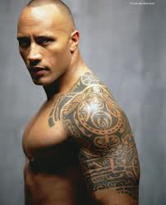
Unit 3: The Skinny on Skin—Integumentary System
3.2
Aim: What are the three layers of the skin and what are they good for?
Real-world connection
tatoos
Vocabulary
Epidermis, dermis, hypodermis, subcutaneous layer
AGENDA
Do Now
Introduction
Mini-Lesson
Summary
Work Period
Exit Slip

Slide 3
Unit 3: The Skinny on Skin—Integumentary System
3.2
Aim: What are the three layers of the skin and what are they good for?
Announcements
Thanksgiving Break Project—Due Friday 12/6/13: Create/Make up your own patient file based on accurate information from an abnormal/weird disease.
AGENDA
Do Now
Introduction
Mini-Lesson
Summary
Work Period
Exit Slip

Slide 4
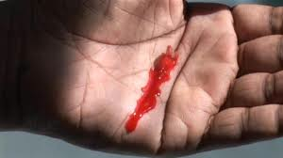
Unit 3: The Skinny on Skin—Integumentary System
3.2
Aim: What are the three layers of the skin and what are they good for?
Think ink…
Pair share
Why is it that when you get a small scratch, you do not bleed, but when you get a deep scratch, you bleed?
Do Now
Introduction
Mini-Lesson
Summary
Work Period
Exit Slip

Slide 5
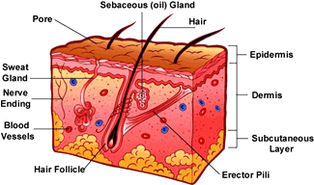
Unit 3: The Skinny on Skin—Integumentary System
3.2
Aim: What are the three layers of the skin and what are they good for?
Parts of the skin
The skin is made of three layers:
Epidermis
Upper epidermis
Lower epidermis
Dermis
Hypodermis (subcutaneous layer)
Do Now
Introduction
Mini-Lesson
Summary
Work Period
Exit Slip

Slide 6
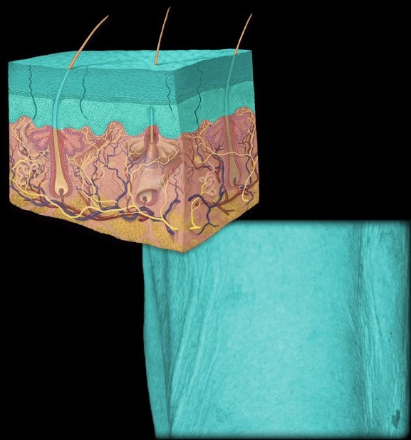
Unit 3: The Skinny on Skin—Integumentary System
3.2
Aim: What are the three layers of the skin and what are they good for?
epidermis
Do Now
Introduction
Mini-Lesson
Summary
Work Period
Exit Slip

Slide 7
Unit 3: The Skinny on Skin—Integumentary System
3.2
Aim: What are the three layers of the skin and what are they good for?
epidermis
Structure: Epidermis | Made up of Living cells & dead cells
Function Protect tissue and organs underneath from damage | Prefix/Suffix Epi = ____________ Dermis = _________
Do Now
Introduction
Mini-Lesson
Summary
Work Period
Exit Slip

Slide 8
Unit 3: The Skinny on Skin—Integumentary System
3.2
Aim: What are the three layers of the skin and what are they good for?
Upper epidermis
Structure: Upper Epidermis | Made up of Dead flattened skin cells; keratin
Function protects the living cells underneath from bacteria, heat and chemicals. | Prefix/Suffix Epi = outer Dermis = skin (Upper epidermis = outer outer skin)
Do Now
Introduction
Mini-Lesson
Summary
Work Period
Exit Slip

Slide 9
Unit 3: The Skinny on Skin—Integumentary System
3.2
Aim: What are the three layers of the skin and what are they good for?
lower epidermis
Structure: Lower Epidermis | Made up of Living cells; melanin
Function To replace the dead cells in upper epidermis Protect skin from sun damage | Prefix/Suffix Epi = outer Dermis = skin (Lower epidermis = lower outer skin)
Do Now
Introduction
Mini-Lesson
Summary
Work Period
Exit Slip

Slide 10
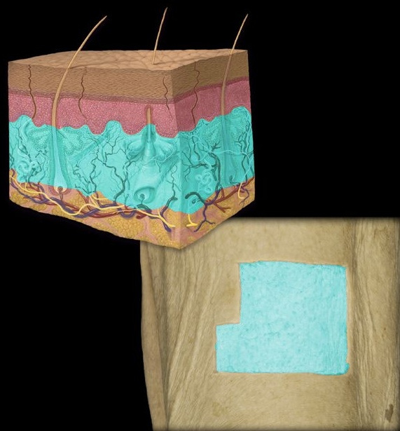
Unit 3: The Skinny on Skin—Integumentary System
3.2
Aim: What are the three layers of the skin and what are they good for?
dermis
Do Now
Introduction
Mini-Lesson
Summary
Work Period
Exit Slip

Slide 11
Unit 3: The Skinny on Skin—Integumentary System
3.2
Aim: What are the three layers of the skin and what are they good for?
dermis
Structure: Dermis | Made up of Collagen & elastic fibers
Function Support epidermis Hold organs like blood vessels, nerves endings, hair follicles and oil and sweat glands. | Prefix/Suffix Dermis = ________
Do Now
Introduction
Mini-Lesson
Summary
Work Period
Exit Slip

Slide 12
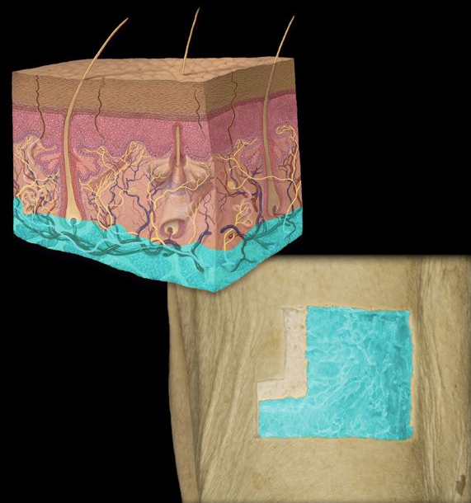
Unit 3: The Skinny on Skin—Integumentary System
3.2
Aim: What are the three layers of the skin and what are they good for?
Hypodermis
(Subcutaneous layer)
Do Now
Introduction
Mini-Lesson
Summary
Work Period
Exit Slip

Slide 13
Unit 3: The Skinny on Skin—Integumentary System
3.2
Aim: What are the three layers of the skin and what are they good for?
hypodermis
Structure: Hypodermis (subcutaneous layer) | Made up of Adipose (fat) tissue
Function Stores fat | Prefix/Suffix Hypo = ___________ sub = _____________ Cutaneous = of the skin
Do Now
Introduction
Mini-Lesson
Summary
Work Period
Exit Slip

Slide 14
Unit 3: The Skinny on Skin—Integumentary System
3.2
Aim: What are the three layers of the skin and what are they good for?
Work period
The functions of the skin include all of these except _____________.
taking in nutrients
preventing the entry of microorganisms
Slowing down water loss
regulating body temperature
Do Now
Introduction
Mini-Lesson
Summary
Work Period
Exit Slip

Slide 15
Unit 3: The Skinny on Skin—Integumentary System
3.2
Aim: What are the three layers of the skin and what are they good for?
Work period
Adipose tissue is most abundant in the ________________ layer under the skin.
A) epidermal
B) dermal
C) subcutaneous
D) transdermal
Do Now
Introduction
Mini-Lesson
Summary
Work Period
Exit Slip

Slide 16
Unit 3: The Skinny on Skin—Integumentary System
3.2
Aim: What are the three layers of the skin and what are they good for?
summary: Lines of learning (LOL)
In a well-written paragraph compare and contrast the three major layers of the skin, noting at least two similarities and two differences.
Do Now
Introduction
Mini-Lesson
Summary
Work Period
Exit Slip

Slide 17
Unit 3: The Skinny on Skin—Integumentary System
3.2
Aim: What are the three layers of the skin and what are they good for?
work period
Finish page 6
Read pages 7-9 about how tatoos work. You must make text annotations! Complete questions on page 10.
Do Now
Introduction
Mini-Lesson
Summary
Work Period
Exit Slip

Slide 18
Unit 3: The Skinny on Skin—Integumentary System
3.2
Aim: What are the three layers of the skin and what are they good for?
HOMEWORK:
Finish pages for 3.2 for homework
Do Now
Introduction
Mini-Lesson
Summary
Work Period
Exit Slip

Slide 19
Unit 3: The Skinny on Skin—Integumentary System
3.2
Aim: What are the three layers of the skin and what are they good for?
Exit Slip
Make sure you get your trackers checked!
Do Now
Introduction
Mini-Lesson
Summary
Work Period
Exit Slip

