Slide 1
Unit 3: The Skinny on Skin—Integumentary System
3.1
Aim: How do our skin’s functions
help our body function overall?
Objective:
I will describe the four functions of the integumentary system.
AGENDA
Do Now
Introduction
Mini-Lesson
Summary
Work Period
QUIZ:
(You have 10-15 minutes)
Exit Slip

Slide 2
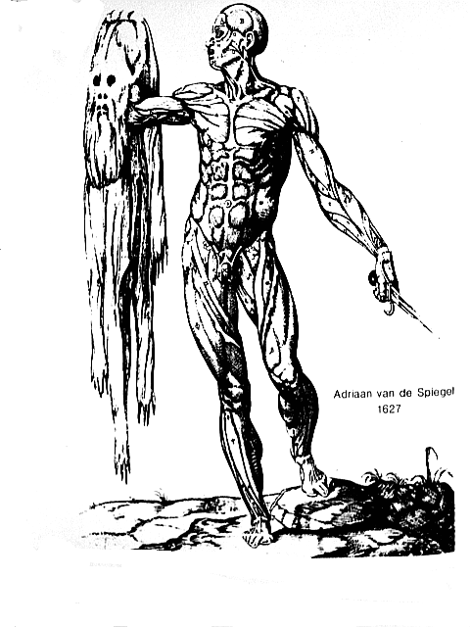
Unit 3: The Skinny on Skin—Integumentary System
3.1
Aim: How do our skin’s functions
help our body function overall?
Real-world connection
Sweating, skin color, protection
Vocabulary
Integumentary system
AGENDA
Do Now
Introduction
Mini-Lesson
Summary
Work Period
Exit Slip

Slide 3
Unit 3: The Skinny on Skin—Integumentary System
3.1
Aim: How do our skin’s functions
help our body function overall?
Announcements
Thanksgiving Break Project—Due Friday 12/6/13: Create/Make up your own patient file based on accurate information from an abnormal/weird disease.
AGENDA
Do Now
Introduction
Mini-Lesson
Summary
Work Period
Exit Slip

Slide 4
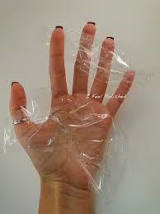
Unit 3: The Skinny on Skin—Integumentary System
3.1
Aim: How do our skin’s functions
help our body function overall?
Think ink…
Pair share
How can you compare skin to plastic wrap that covers food that we place in the freezer?
Do Now
Introduction
Mini-Lesson
Summary
Work Period
Exit Slip

Slide 5
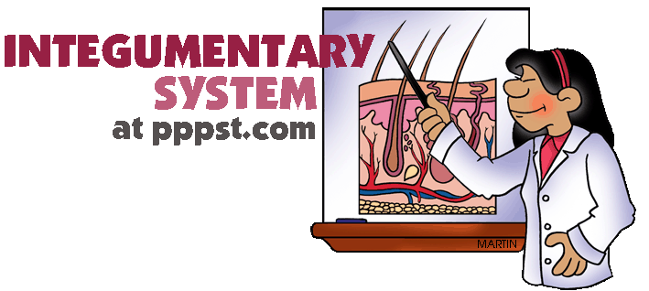
Unit 3: The Skinny on Skin—Integumentary System
3.1
Aim: How do our skin’s functions
help our body function overall?
Your skin!
The skin is an organ system called integumentary system
Facts:
Makes up 16% of total body weight
Largest organ system of body
Do Now
Introduction
Mini-Lesson
Summary
Work Period
Exit Slip

Slide 6
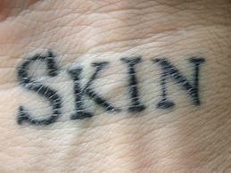
Unit 3: The Skinny on Skin—Integumentary System
3.1
Aim: How do our skin’s functions
help our body function overall?
Parts of integumentary system
Skin
Hair
Nails
Sweat glands
Oil glands
Do Now
Introduction
Mini-Lesson
Summary
Work Period
Exit Slip

Slide 7
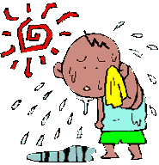
Unit 3: The Skinny on Skin—Integumentary System
3.1
Aim: How do our skin’s functions
help our body function overall?
Functions of the skin:
Temperature Maintenance
The production of perspiration by sweat glands help to lower body temperature back to normal
Do Now
Introduction
Mini-Lesson
Summary
Work Period
Exit Slip

Slide 8
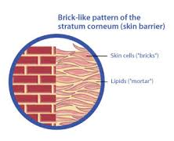
Unit 3: The Skinny on Skin—Integumentary System
3.1
Aim: How do our skin’s functions
help our body function overall?
Functions of the skin:
2. Protection
Skin covers the body and acts as a physical barrier that protects underlying tissues from physical cuts, bacterial invasions, dehydration, and sunburn.
Do Now
Introduction
Mini-Lesson
Summary
Work Period
Exit Slip

Slide 9
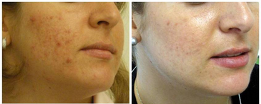
Unit 3: The Skinny on Skin—Integumentary System
3.1
Aim: How do our skin’s functions
help our body function overall?
Functions of the skin:
3. Excretion
The skin gets rid of small amounts of water, slats, and other organic compounds.
Do Now
Introduction
Mini-Lesson
Summary
Work Period
Exit Slip

Slide 10
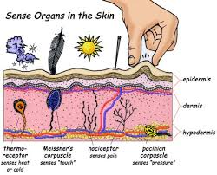
Unit 3: The Skinny on Skin—Integumentary System
3.1
Aim: How do our skin’s functions
help our body function overall?
Functions of the skin:
4. Sensory Reception
(sensitivity) The skin contains numerous nerve endings that detect stimuli related to temperature, touch, pressure, and pain.
Do Now
Introduction
Mini-Lesson
Summary
Work Period
Exit Slip

Slide 11
Unit 3: The Skinny on Skin—Integumentary System
3.1
Aim: How do our skin’s functions
help our body function overall?
Work period
You will go upstairs in the lab
to complete lab activity on page 3
Do Now
Introduction
Mini-Lesson
Summary
Work Period
Exit Slip

Slide 12
Unit 3: The Skinny on Skin—Integumentary System
3.1
Aim: How do our skin’s functions
help our body function overall?
HOMEWORK:
Finish pages for 3.1 for homework
Do Now
Introduction
Mini-Lesson
Summary
Work Period
Exit Slip

Slide 13
Unit 3: The Skinny on Skin—Integumentary System
3.1
Aim: How do our skin’s functions
help our body function overall?
Exit Slip
Make sure you get your trackers checked!
Do Now
Introduction
Mini-Lesson
Summary
Work Period
Exit Slip

