Slide 1
Unit 2: Talking Like a Doctor—Introduction of Human Body
2.6
Aim: How do doctors obtain information needed to make a diagnosis?
Objective:
I will identify and apply the questions doctors ask to make a diagnosis.
AGENDA
Do Now
Introduction
Mini-Lesson
Summary
Work Period
QUIZ:
(You have 10-15 minutes)
Exit Slip

Slide 2
Unit 2: Talking Like a Doctor—Introduction of Human Body
2.6
Aim: How do doctors obtain information needed to make a diagnosis?
Real-world connection
Getting treated for sickness
Vocabulary
Family history, symptoms, causes/risk factors, diagnosis, treatment, future prevention, prognosis
AGENDA
Do Now
Introduction
Mini-Lesson
Summary
Work Period
Exit Slip

Slide 3
Unit 2: Talking Like a Doctor—Introduction of Human Body
2.6
Aim: How do doctors obtain information needed to make a diagnosis?
Announcements
PAST DUE: Typed Lab Report Due COMING SOON: Unit #2 Test is on Tues 11/19/13
AGENDA
Do Now
Introduction
Mini-Lesson
Summary
Work Period
Exit Slip

Slide 4
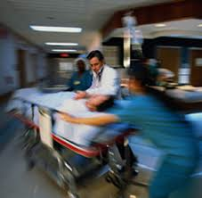
Unit 2: Talking Like a Doctor—Introduction to Human Body
2.6
Aim: How do doctors obtain information needed to make a diagnosis?
Think …
What happens when you go to the emergency room?
Do Now
Introduction
Mini-Lesson
Summary
Work Period
Exit Slip

Slide 5
Unit 2: Talking Like a Doctor—Introduction to Human Body
2.6
Aim: How do doctors obtain information needed to make a diagnosis?
Do Now
Introduction
Mini-Lesson
Summary
Work Period
Exit Slip

Slide 6
Unit 2: Talking Like a Doctor—Introduction to Human Body
2.6
Aim: How do doctors obtain information needed to make a diagnosis?
Do Now
Introduction
Mini-Lesson
Summary
Work Period
Exit Slip

Slide 7
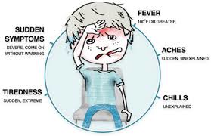
Unit 2: Talking Like a Doctor—Introduction to Human Body
2.6
Aim: How do doctors obtain information needed to make a diagnosis?
DOCTORS NOTES
When you feel sick, the different ways you feel are called symptoms of the sickness.
Factors that can increase a person from getting sick are called risk factors
Do Now
Introduction
Mini-Lesson
Summary
Work Period
Exit Slip

Slide 8
Unit 2: Talking Like a Doctor—Introduction to Human Body
2.6
Aim: How do doctors obtain information needed to make a diagnosis?
observations
When the doctor collects information from tests, he is collecting medical history.
Based on the medical data the doctor has collected, he can make a diagnosis, or a declaration of what the sickness or disease is.
Do Now
Introduction
Mini-Lesson
Summary
Work Period
Exit Slip

Slide 9
Unit 2: Talking Like a Doctor—Introduction to Human Body
2.6
Aim: How do doctors obtain information needed to make a diagnosis?
inferences
Doctor makes treatment, which will help the patient to get better.
Doctor makes suggestions on how to prevent the sickness from happening again.
Do Now
Introduction
Mini-Lesson
Summary
Work Period
Exit Slip

Slide 10
Unit 2: Talking Like a Doctor—Introduction to Human Body
2.6
Aim: How do doctors obtain information needed to make a diagnosis?
As a Doctor, we need…
Basic Info about the patient (Age, height, weight, etc)
Family history: info about diseases that direct blood family members (i.e. mom, dad, grandparents) have suffered
Do Now
Introduction
Mini-Lesson
Summary
Work Period
Exit Slip

Slide 11
Unit 2: Talking Like a Doctor—Introduction to Human Body
2.6
Aim: How do doctors obtain information needed to make a diagnosis?
As a Doctor, we need…
Symptoms: physical or mental aspect that is a sign of a disease
Causes/Risk factors: conditions that increase the chance of a disease
Do Now
Introduction
Mini-Lesson
Summary
Work Period
Exit Slip

Slide 12
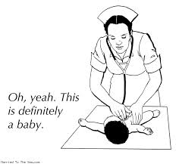
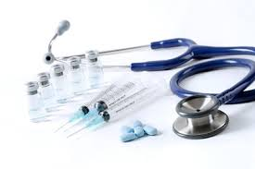
Unit 2: Talking Like a Doctor—Introduction to Human Body
2.6
Aim: How do doctors obtain information needed to make a diagnosis?
As a Doctor, we need…
Diagnosis: identifying an illness through examination & symptoms
Treatment: management and care of a patient with a disease
Do Now
Introduction
Mini-Lesson
Summary
Work Period
Exit Slip

Slide 13
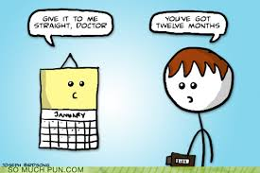
Unit 2: Talking Like a Doctor—Introduction to Human Body
2.6
Aim: How do doctors obtain information needed to make a diagnosis?
As a Doctor, we need…
Future Prevention: ways to avoid a disease occurring
Prognosis: predicting likely outcome and recovery from an illness
Do Now
Introduction
Mini-Lesson
Summary
Work Period
Exit Slip

Slide 14
Unit 2: Talking Like a Doctor—Introduction to Human Body
2.6
Aim: How do doctors obtain information needed to make a diagnosis?
Doc-Patient Interview
Two people will act it out
Everyone else will follow along and take notes
Let’s go over chart!
Do Now
Introduction
Mini-Lesson
Summary
Work Period
Exit Slip

Slide 15
Unit 2: Talking Like a Doctor—Introduction of Human Body
2.6
Aim: How do doctors obtain information needed to make a diagnosis?
Work period
You are now ask to write letter to Dr. Francois (head doctor), explaining the scenario in the following format
LETTER ORGANIZER
Do Now
Introduction
Mini-Lesson
Summary
Work Period
Exit Slip

Slide 16
Unit 2: Talking Like a Doctor—Introduction of Human Body
Thesis
I am diagnosing the disease as _______________________________ because
Topic Sentence #1
During my interview, the patient mentioned that in her family
Topic Sentence #2
Topic Sentence #3
Conclusion
In order to treat this, the patient should
If the disease is not treated soon, then
It will go on to affect other body systems, such as
To prevent this from happening I told the patient to
Some signs of __________________ I saw were
Do Now
Introduction
Mini-Lesson
Summary
Work Period
Exit Slip

Slide 17
Unit 2: Talking Like a Doctor—Introduction of Human Body
2.6
Aim: How do doctors obtain information needed to make a diagnosis?
HOMEWORK:
Finish pages for 2.6 for homework
Do Now
Introduction
Mini-Lesson
Summary
Work Period
Exit Slip

Slide 18
Unit 2: Talking Like a Doctor—Introduction of Human Body
2.6
Aim: How do doctors obtain information needed to make a diagnosis?
Exit Slip
Make sure you get your trackers checked!
Do Now
Introduction
Mini-Lesson
Summary
Work Period
Exit Slip

